Slide 1
Team 20 - Database Project
Group Members:
Dane Rigby
Jordan Mryyan
Cole Robertson
William Yeager
Yinglun Zhang

Slide 2
01
Overview
Brief overview of the project, and a clear definition of target users
02
Scenario
How users interact with our system
Intro
03
Design and Implementation
Technical details
04
Demonstration
And also show the potential for future expansion.
05
Questions?

Slide 3
Overview
01
This project's aim is to create an interface to search for class reviews as well as manage students in a class.
There will be an administrator view to manage courses and reviews as well as a student view to search for courses for enrollment purposes and leave a review on courses.
In terms of entities represented in the database there are a few key ones. There is the main course, which represents a unique course based on the time, location, and instructor.
In that same vein there is also a class type which represents whether the course is a lecture, recitation, lab or independent study. There is also an instructor model that represents an instructor, a student model which represents a student etc. Intent is to make the class and instructor data real but fake the reviews and students.

Slide 4
Target Users
Current Student
Find out the most popular course
Enroll into classes quickly
See what others thought of a class
KSU
Instructors
View what classes a student is in
See class reviews to improve teaching

Slide 5
Scenario
02
Here comes a good story
for those of you who are falling asleep

Slide 6
Most frequently used features
Classes
Student
Instructor
Find
Enroll
Reviews
Search and filter for classes
View and add student to class
Look through the reviews of a course and filter by Instructor

Slide 7
Design and Implementation
03
C# ASP.Net MVC for all database and interface portions
Python for scraping the K-State websites

Slide 8
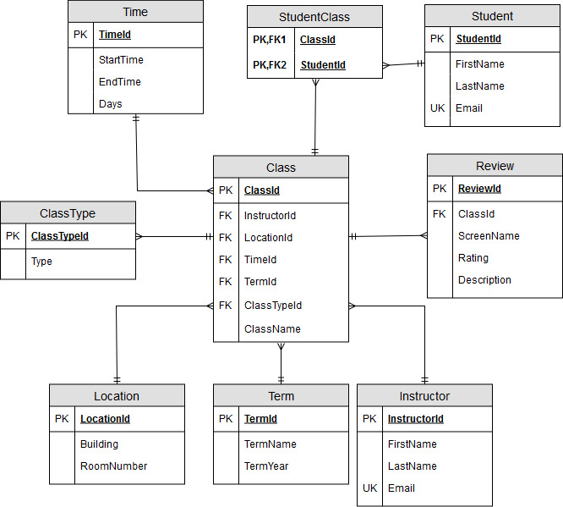
Database Design

Slide 9
Demo
04
Fun time

Slide 10
Why the system is important for the target users
Makes enrollment and class searching quick and painless
Helps students know what to expect going into a course
Allows K-State staff to see which courses students are consistently liking/disliking
The open feedback system will help professor get a genuine idea of what they can improve on

Slide 11
Possible future expansion
DLC 1
DLC 4
Better search and filtering
Drop/Switch Classes
DLC 2
DLC 5
Student Login
Admin Panel
DLC 3
DLC 6
Show if class open
Enroll in/View waitlist

Slide 12
Thanks!
Questions?

